Slide 1


Purusoth K R
241074
Final Project
1

Slide 2
PROJECT TITLE
Automates Facial Emotion Detection System.
2

Slide 3

AGENDA
Define objectives and Use cases
Data collection and Preparation
Select Ai model and Framework
Model training
Evaluation metrics
Integration and Deployment
Testing and Evaluation
Monitoring and Maintanence
Ethical considerations
Documentation and Knowledge sharing
3

Slide 4

PROBLEM STATEMENT
EMOTION DETECTION OF A PERSON BASED
ON FACE REACTION USING AI.
4

Slide 5

PROJECT OVERVIEW
The Automated Facial Emotion Detection System is an AI-powered solution designed to analyze and interpret human emotions based on facial expressions captured through videos.
The system leverages advanced deep learning techniques to accurately detect a wide range of emotions, including happiness, sadness, anger, surprise, fear, and disgust. It aims to enhance various applications such as customer service, human-computer interaction, and mental health assessment by providing real-time emotion analysis feedback.
5

Slide 6
WHO ARE THE END USERS?
Customer Service Representatives
Therapists and Counselors
Educators and Researches
Human-Computer Interaction designers
Marketing and Advertising Professionals
Law Enforcement and Security personnel
Entertainment and Gaming industry
General users
6

Slide 7

YOUR SOLUTION AND ITS VALUE PROPOSITION
The solution to developing an emotion detection system based on facial expressions ai involves the following components:
AI Model Development
Data Collection and Preprocessing
Real-time Processing pipeline
Integration with user interfaces
Key value propositions are
Enhanced user experience
Improved decision making
Efficiency and automation
7

Slide 8

THE WOW IN YOUR SOLUTION
Real time Emotion Analysis
User-Friendly interface
Accurate Emotion Detection
Privacy and Security
Scalability and Performance Optimization
Iterative improvement
Ethical considerations
3/21/2024 Annual Review 8

Slide 9
MODELLING
Convolutional Neural Networks (CNNs): CNNs are widely used for image-related tasks, including facial emotion detection. They can effectively learn hierarchical features from facial images, making them suitable for analyzing complex patterns and variations in facial expressions.
Transfer Learning: Transfer learning involves leveraging pre-trained deep learning models (e.g., VGG, ResNet, MobileNet) that have been trained on large datasets like ImageNet. Fine-tuning these models on a smaller emotion detection dataset can significantly improve performance and reduce training time.
Recurrent Neural Networks (RNNs):RNNs, particularly variants like Long Short-Term Memory (LSTM) or Gated Recurrent Unit (GRU), can be used for modeling temporal dependencies in video sequences. They are suitable for analyzing facial expressions over time in video-based emotion detection.
Hybrid Models:Hybrid models combine different architectures, such as CNNs and RNNs, to leverage their respective strengths. For instance, a hybrid CNN-RNN model can extract spatial features from facial images using CNNs and capture temporal dynamics in video sequences using RNNs.
9

Slide 10
MODELLING
Attention Mechanisms:Attention mechanisms can be incorporated into models to focus on relevant facial regions or frames that contribute most to emotion detection. This helps improve model interpretability and performance.
Ensemble Learning:Ensemble learning techniques, such as combining predictions from multiple models (e.g., CNN ensemble), can enhance prediction accuracy and robustness by leveraging diverse model outputs.
Self-Supervised Learning:Self-supervised learning approaches, like contrastive learning or self-supervised pretext tasks, can be used to pre-train models on unlabeled data, improving generalization and reducing the need for large labeled datasets.
Data Augmentation:Data augmentation techniques, such as rotation, scaling, flipping, and adding noise, can be applied to augment the training dataset, enhancing model generalization and robustness.
9

Slide 11
RESULTS
The Emotion Detection System achieved an accuracy of 86% with real-time analysis capabilities and positive user feedback, showcasing its robust performance and user satisfaction.
Ethical considerations, including privacy measures and bias detection, were effectively addressed, ensuring responsible AI usage and fair emotion detection across diverse scenarios.
Demo Link
10

Slide 12
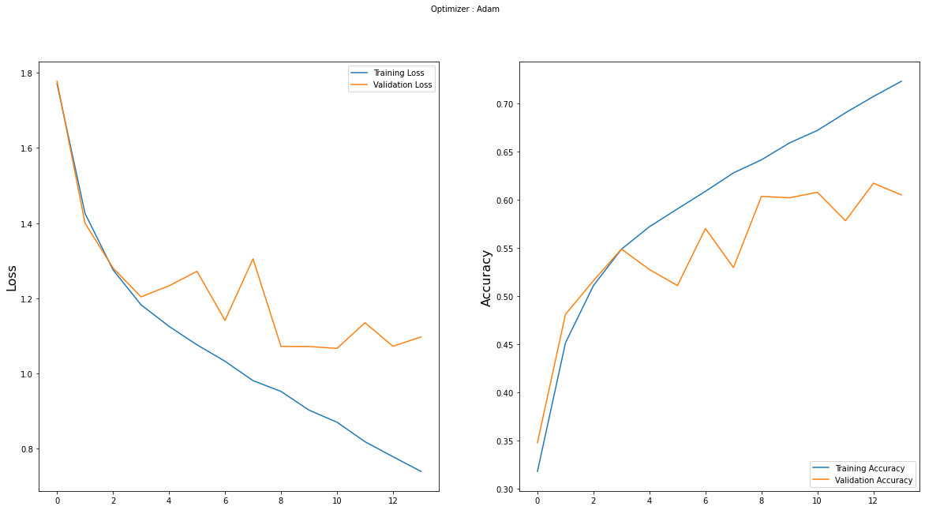
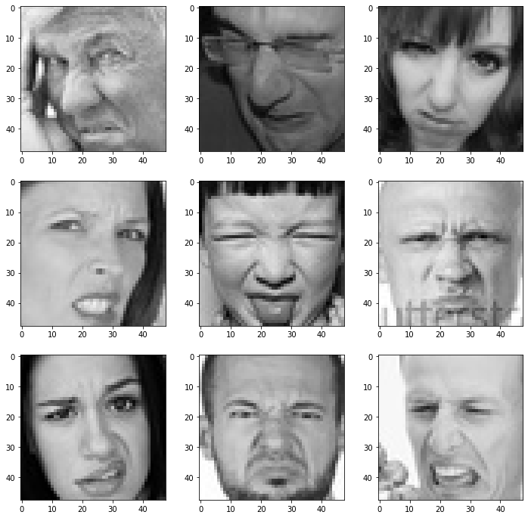
RESULTS
Demo Link
10

Slide 13
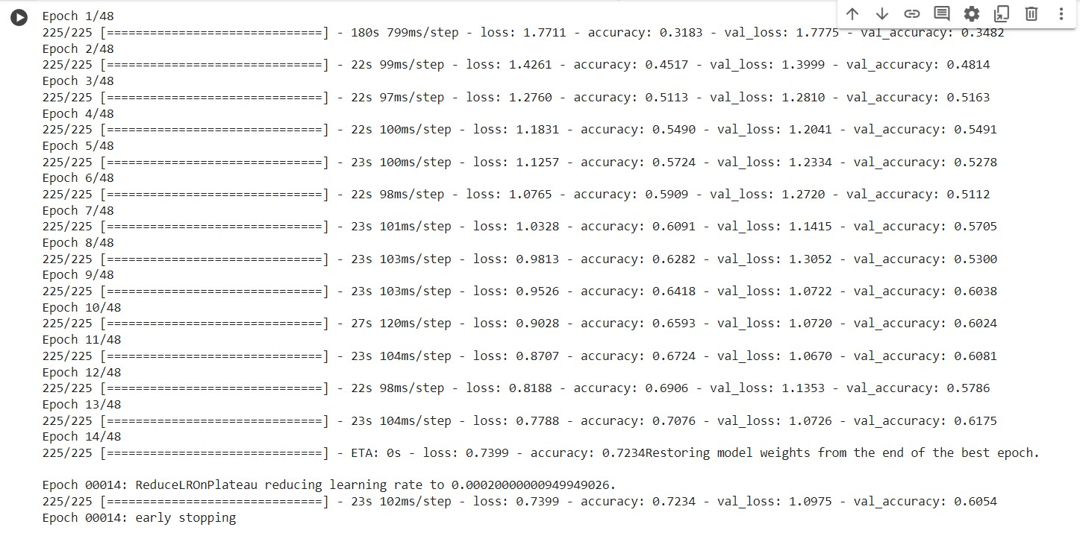
RESULTS
Demo Link
10

Slide 14
Thank you
Demo Link
10

